Slide 1
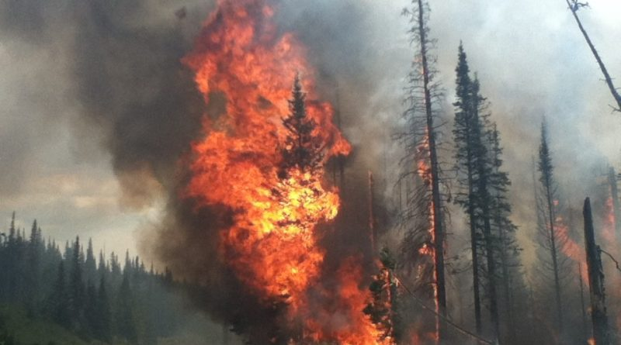

Scorched!
An analysis of
U.S. Wildfires
from 1992-2015
By
k.E.G.d
Katlin, Enzo,
Graham, and Danieli

Slide 2
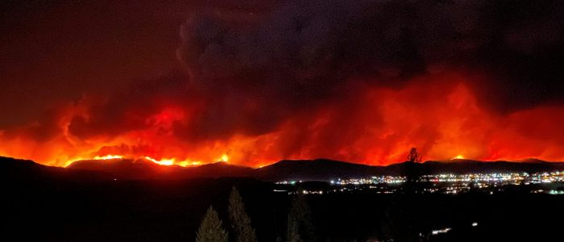
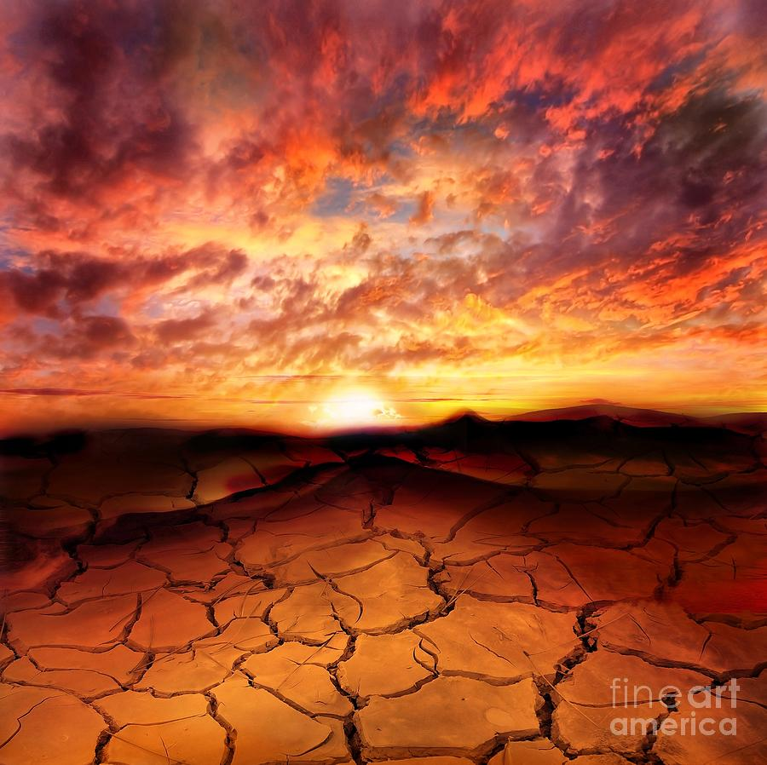
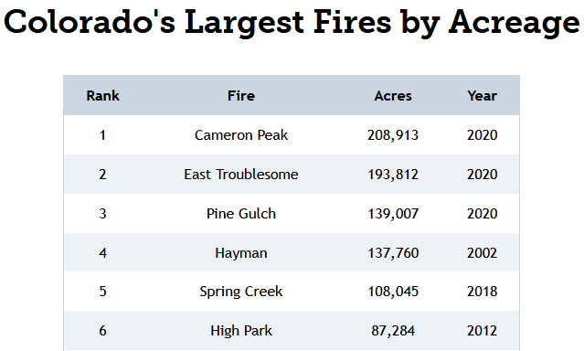
Why Study Wildfires?
Per the Environmental Protection Agency,
Wildfires have the potential to harm property, livelihoods, and human health.
Studies show that climate change has already led to an increase in wildfire season length, wildfire frequency, and burned area.
Per the Colorado Division of Fire Prevention and Control - Top 5 all since 2018

Slide 3
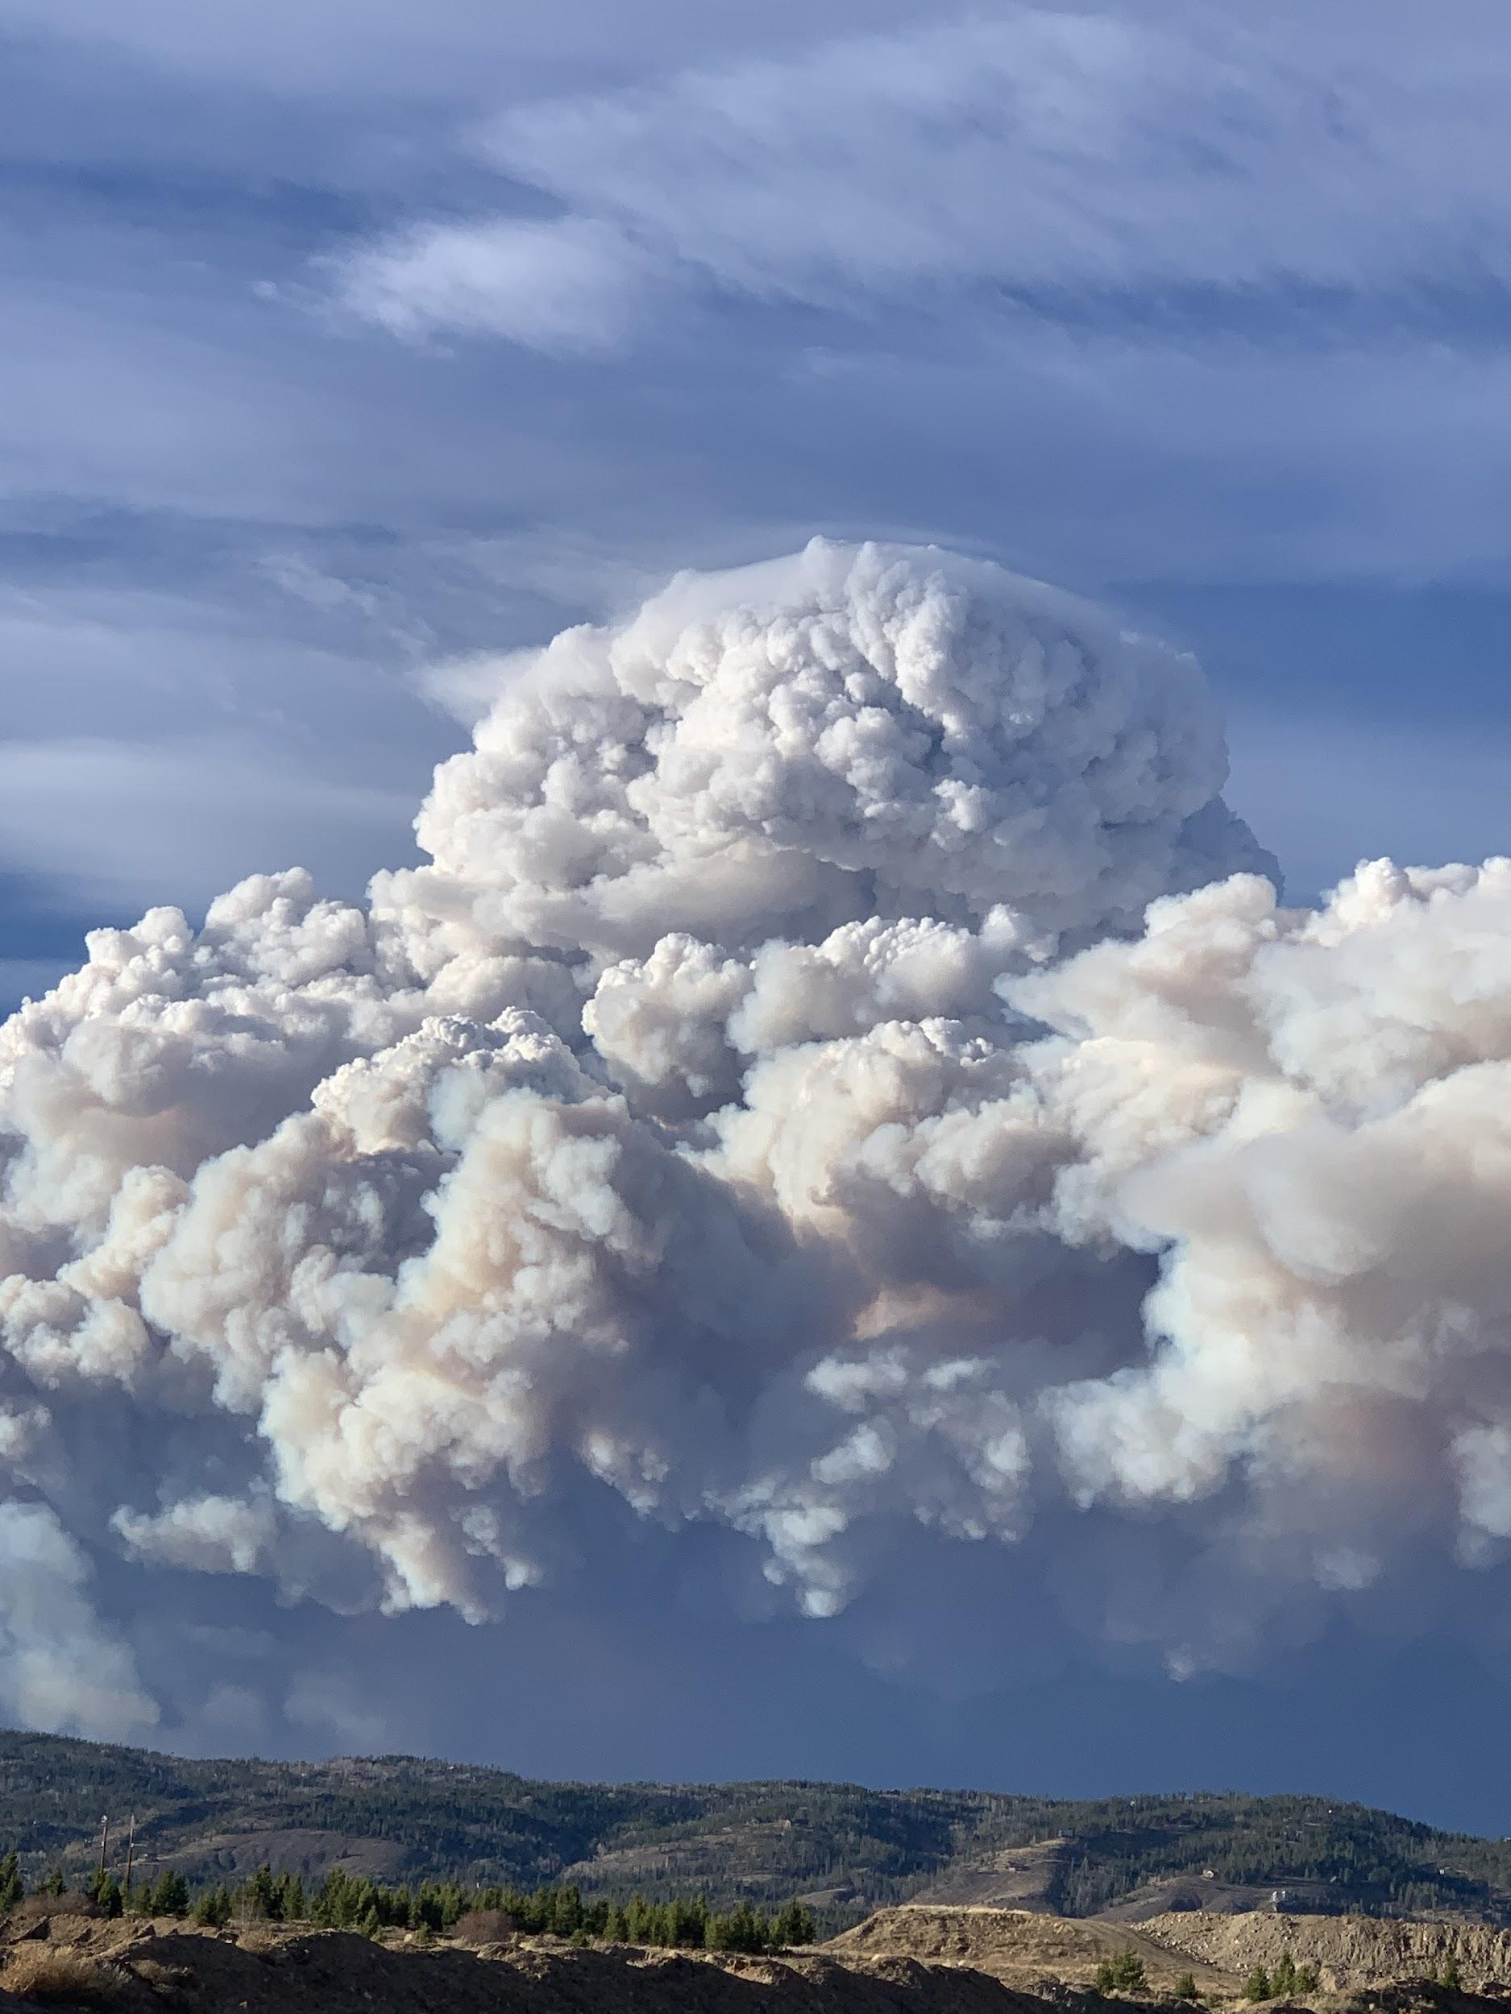
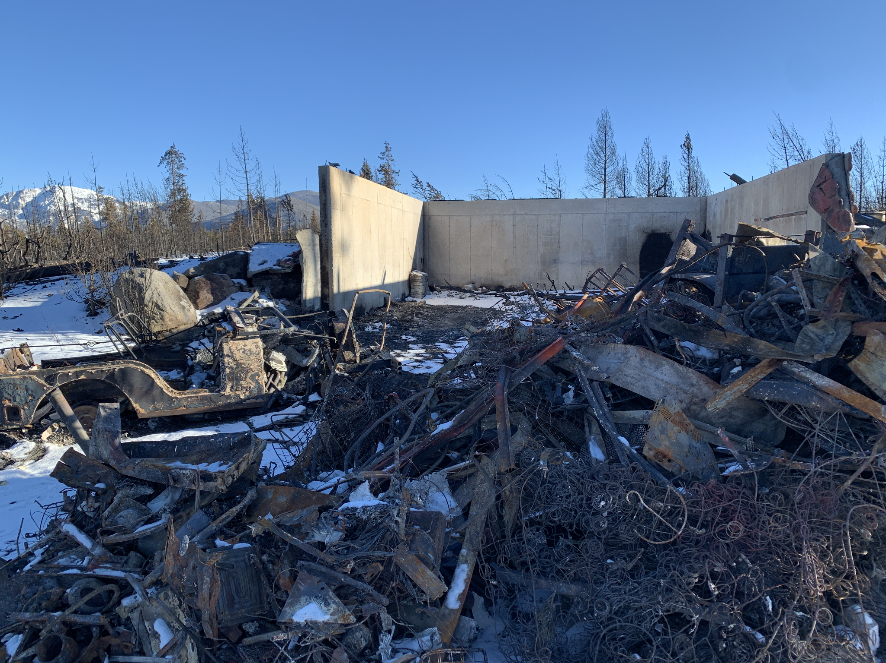
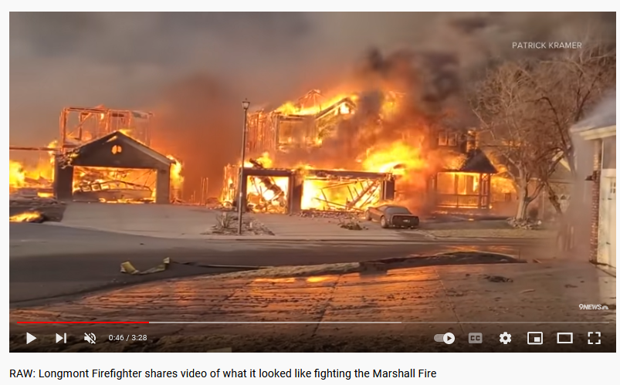
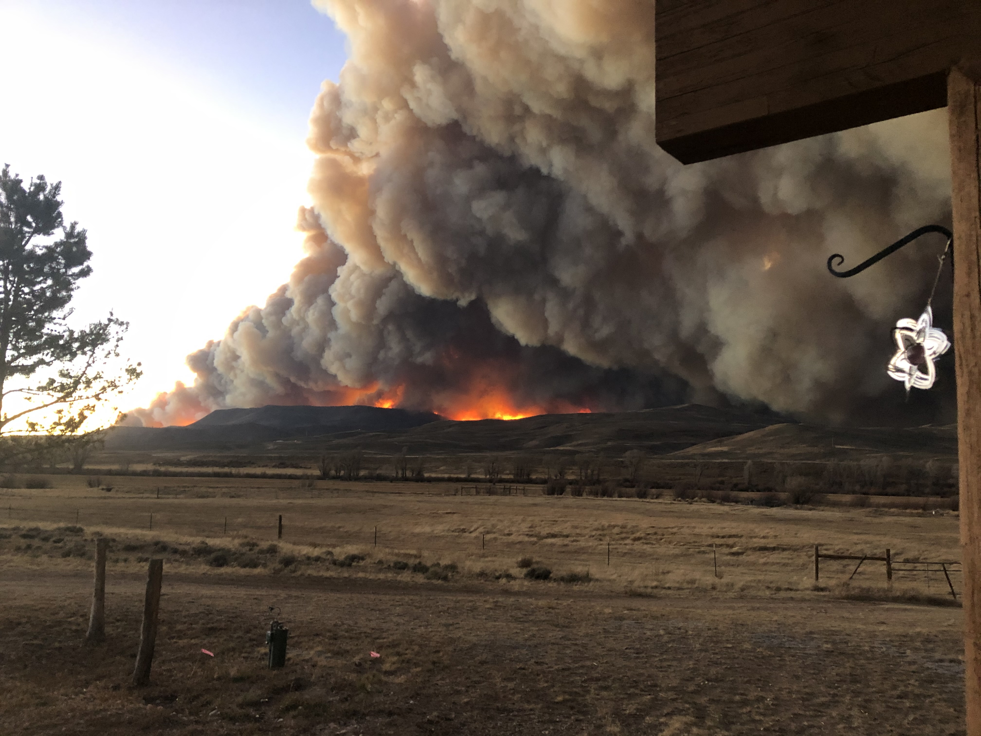
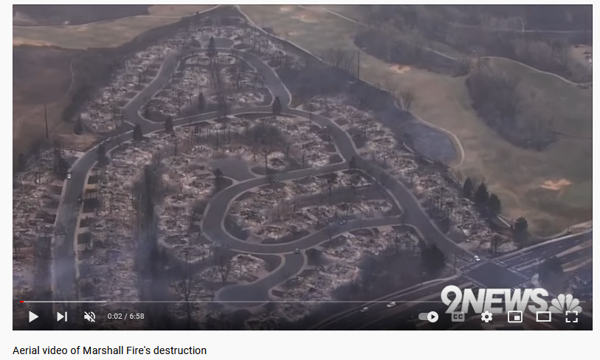
Wildfires Close to Home
East Troublesome Fire, Oct 2020
Marshall Fire, Dec 2021

Slide 4
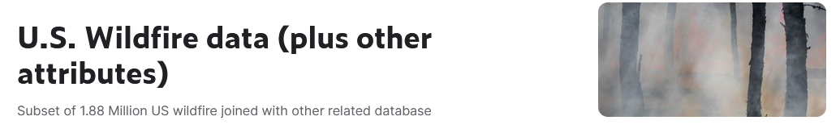

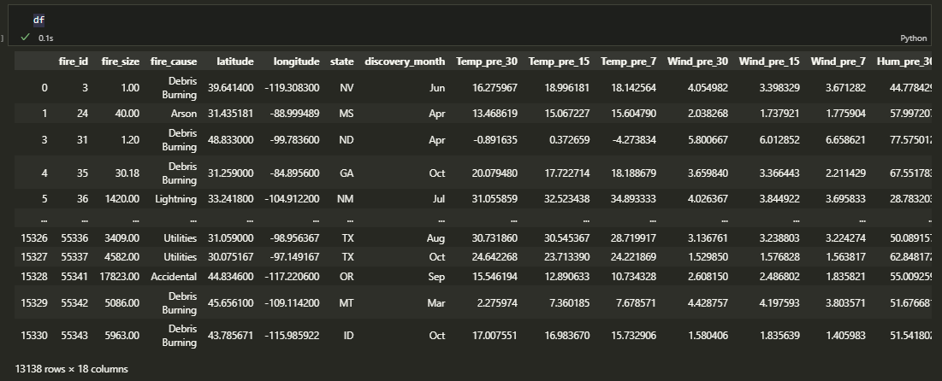
Data Source
U.S. Wildfire data (plus other attributes)
https://www.kaggle.com/datasets/capcloudcoder/us-wildfire-data-plus-other-attributes
Entire dataset - 55,367 rows / 43 columns
Cleaned dataset - 13,138 rows / 18 columns

Slide 5
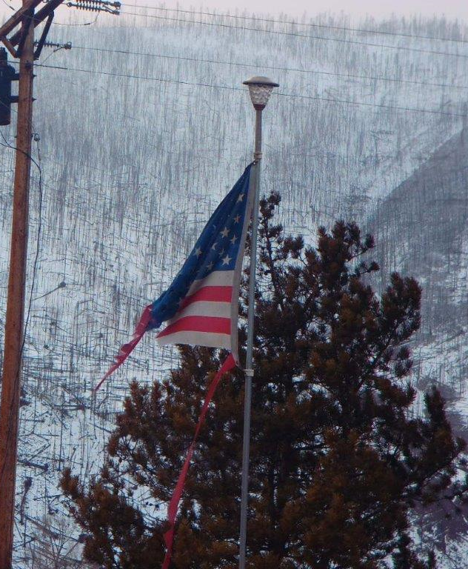
Questions to Investigate
Has the number, size, and cause of wildfires changed over time? (general analysis and visualization)
Has the timing and distribution of wildfires changed over time? (general analysis and visualization)
Can temperature, wind, humidity, discovery month, and state be used to predict whether a fire will grow to at least 50 acres in size? (machine learning)

Slide 6
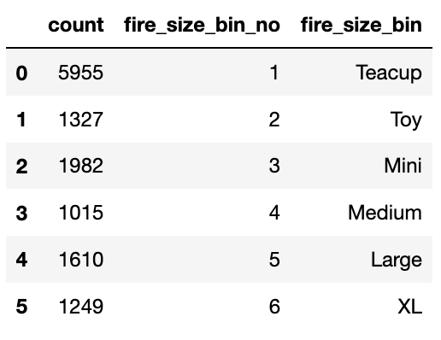
Data PreProcessing: Newly Categorized Fire Size Bins
Binned fire sizes to get a better view of proportions and more it easier to work within a machine learning models.
Teacup: 0-5 acres
Toy: 5-10 acres
Mini: 10-50 acres
Medium: 50-1,000 acres
Large: 1,000-10,000 acres
XL: 10,000 + acres

Slide 7
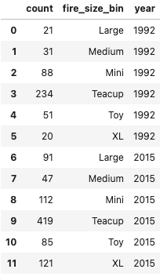
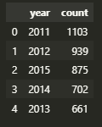
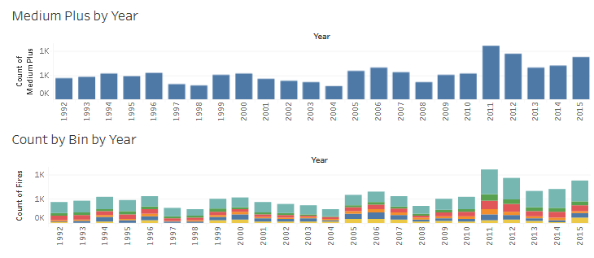
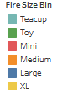
Data Analysis: Bin Comparison by Year
Nearly all bin counts have increased between 1992-2015.
Top 5 fire counts are last 5 years in study period.

Slide 8
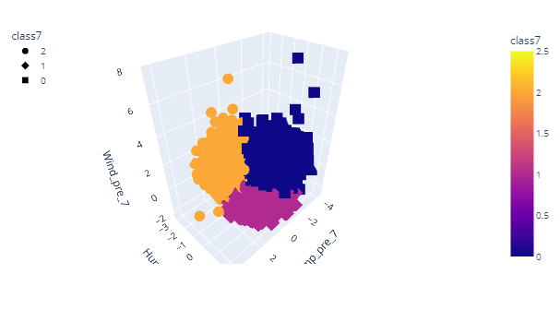
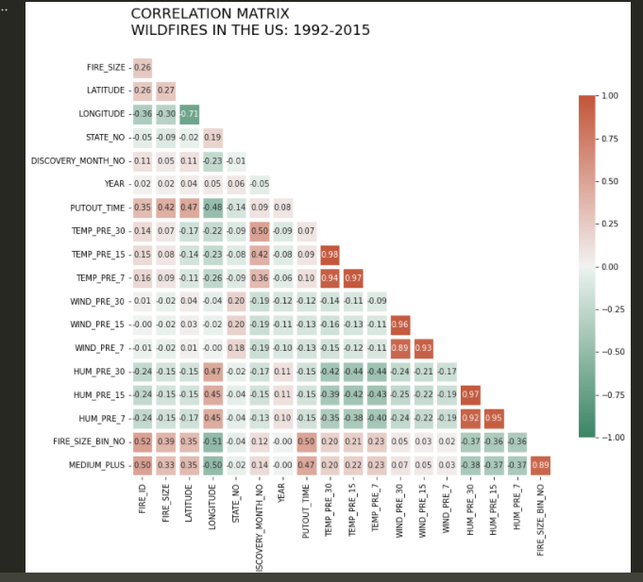
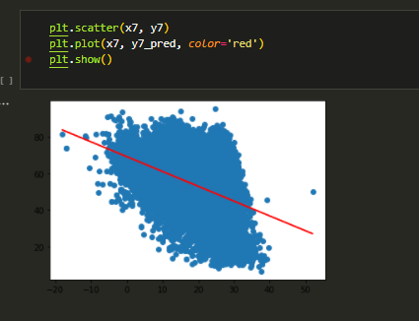
Data Analysis: Other Charts
KMeans Clusters of Pre-7 Weather Data
Pre-7 Linear Regression of Temperature (x)
vs Humidity (y)

Slide 9
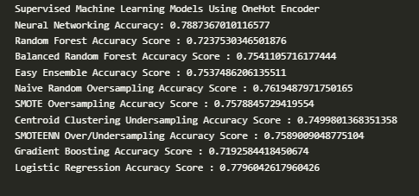
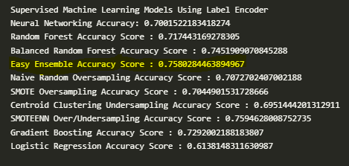
Data Analysis: Supervised Machine Learning
Target (y) value: 'medium_plus'
X values: 'state', 'discovery_month', 'Temp_pre_7', 'Hum_pre_7', 'Wind_pre_7'
One-Hot Encoder
Label Encoder

Slide 10
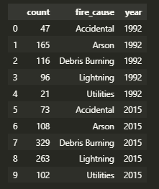
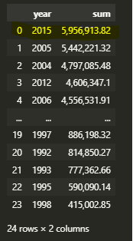
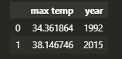
Analytic Conclusions
The size of fires has steadily increased over the 23 year period.
The total square acreage of burned area has hit a 23 year high in 2015.
Increase in fire size may be a result of increase in temperatures during the study period.

Slide 11
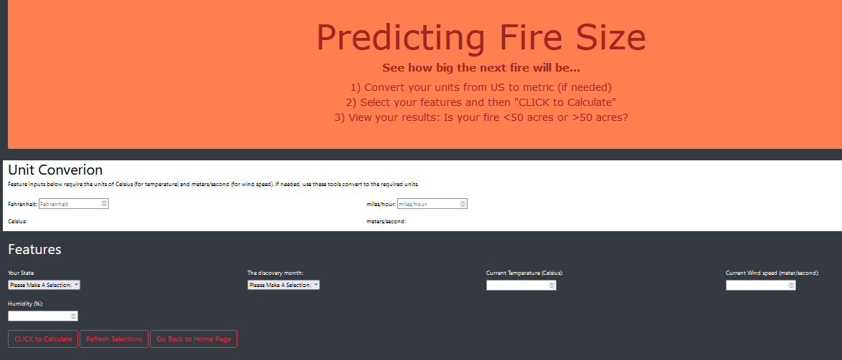
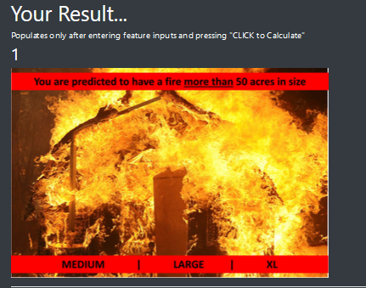
Predicting Fire Size: See How Big the Next Fire Will Be
Check out our Prediction Web App…

Slide 12
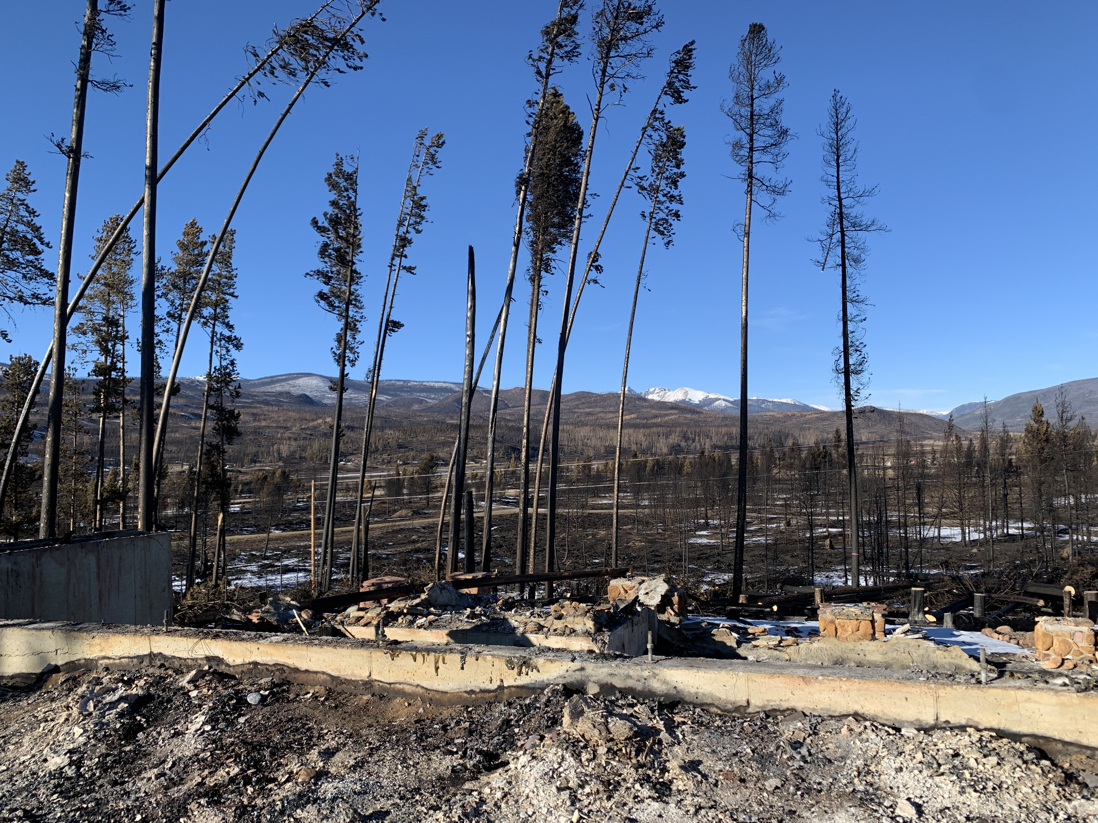
Real Life Applications
With this fire prediction tool, first responders may address
Asset relocation
Early containment
Possible evacuation areas
Prevent future loss of life and minimize property damage
Help with resource and funding requests
Highlight highly affected areas that need attention

Slide 13
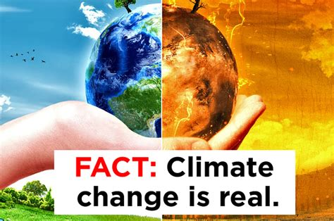
Climate Change
As the climate change crisis now creates conditions that are deteriorating and causing worse destruction, having the capability to determine potential fire size is essential.
Climate change affects us all and needs to be a topic of discussion at all levels of government and public forum.
Tools like this one that are easy to understand and bring pertinent issues to the forefront are needed to bring us all in the fight for a more stable future.

Slide 14
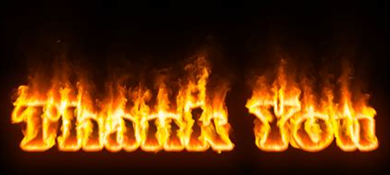
Credits / Thank Yous
Team k.E.G.d. wishes to thank our instructor, Svitlana, and our T.A.s, James, Sheri, and Simon, for all their assistance on this project.
Credit is also due to Team Lizard People, and their Conspiracy Theory project, for inspiration when our coding struggles got real.
Lastly, without DU’s Data Analytics Bootcamp, this team and our project wouldn’t even exist!!!

